Slide 1
RAS-Funded Project on Creation of Educational
Material-Case Study of Modeling and Control in
Energy-Efficient Buildings
Qianchuan Zhao
zhaoqc@tsinghua.edu.cn
Center for Intelligent and Networked Systems (CFINS)
Department of Automation
Tsinghua University, Beijing 100084, China

Slide 2
Intention and timetable
Intention
Develop an online resource center to host case studies of modeling and control in energy-efficient buildings
Create educational material for researchers to learn popular simulation software in the field
Help the users to enter this field through test of control and optimization methodologies on some real test beds
Case studies
Building envelope design for a single-zone welding shop.
Investigate the value of a north-light roof in lowering building energy consumption.
Multiple-chiller plant simulation platform.
Host links to various existing testbeds.
http://cfins.au.tsinghua.edu.cn/sbtc/demo/cases.html

Slide 3
Case 1-Building envelope design (EnergyPlus)
Design the building envelope for a single-zone welding shop
Control some parameters of the building envelope to achieve low energy consumption.
Building orientation, shape coefficient (the ratio between the external skin surfaces and the inner volume of the building) and window-to-wall ratio are chosen to be controlled to obtain high energy efficiency
Two related tools presented
An EnergyPlus-integrated building energy estimation tool
Building envelope optimization tool
N
H
α
A_{win}
l
H_{door}
W_{door}
w
Case 1

Slide 4
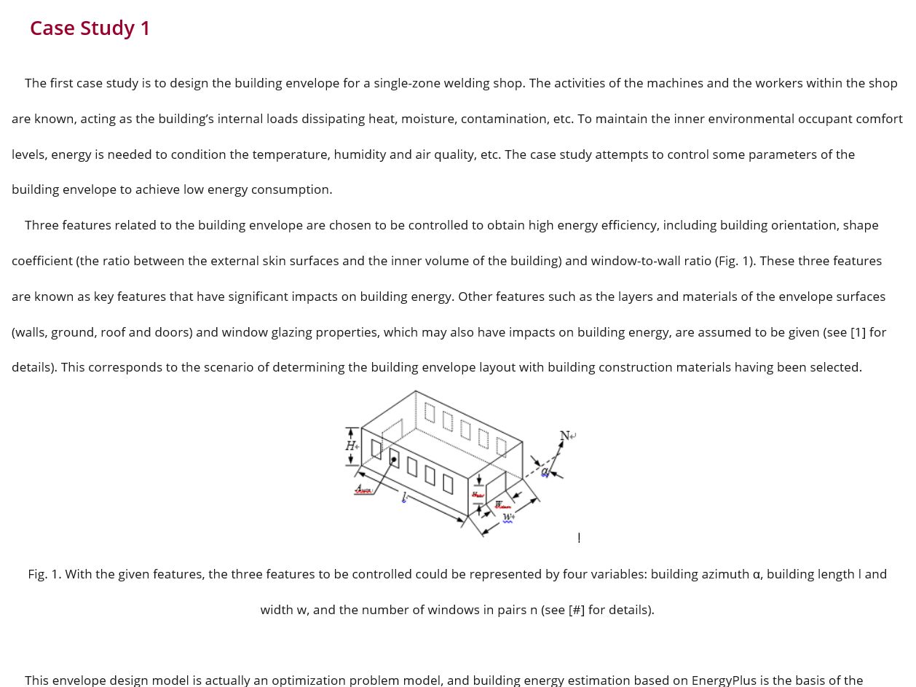
Case 1 in the website

Slide 5
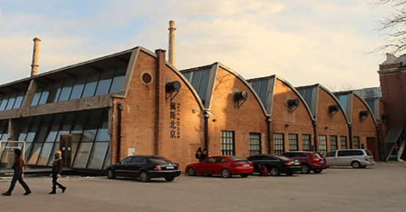
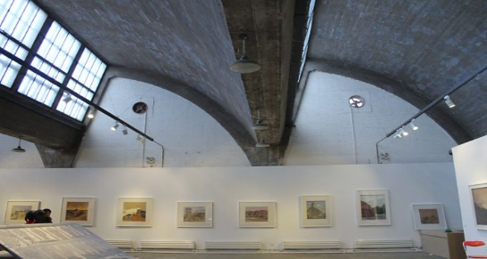
Case 2-Investigate the value of a north-light roof (EnergyPlus)
Investigate the value of a traditional north-light roof in lowering building energy consumption
increased air volume
Increased heating and cooling loads requirements, leading eventually to higher HVAC energy demands
Increased heat losses
Three tools presented
The first tool helps to show the north-light roof is not always good for locations of different climate zones
The second tool estimates the building energy for user specified roof configuration and location
The third tool finds an optimized north-light roof shape for a certain user-specified location
Case 2

Slide 6
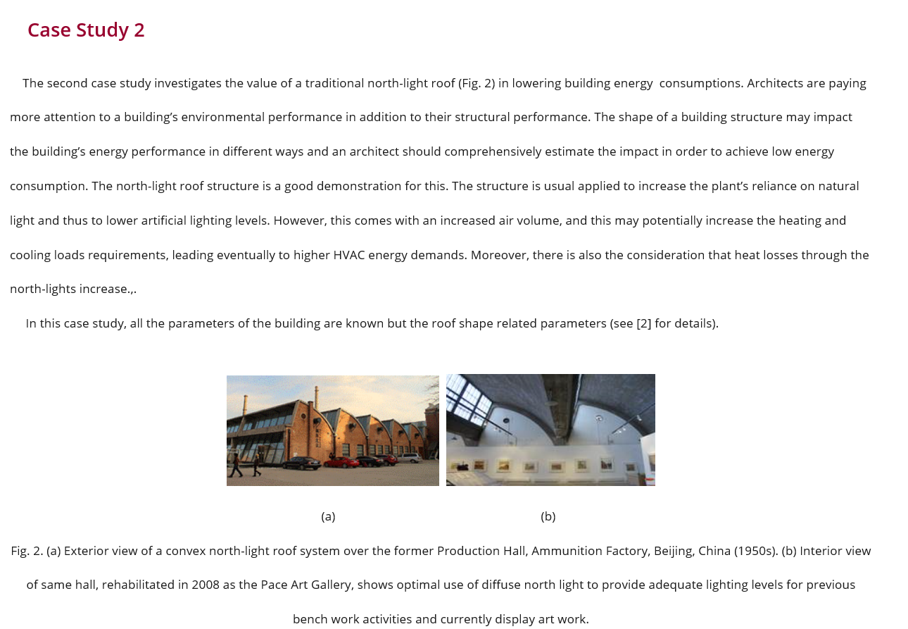
Case 2 in the website

Slide 7
Case 3- Multiple-chiller plant simulation platform(TRNSYS)
A simulation platform is constructed for a typical multiple-chiller plant
This platform can be used for
Energy performance evaluation of multiple-chiller plant
Components (AHUs, pumps, valves) performance evaluation
Chiller sequencing control
Chilled water supply temperature optimization
Case 3

Slide 8
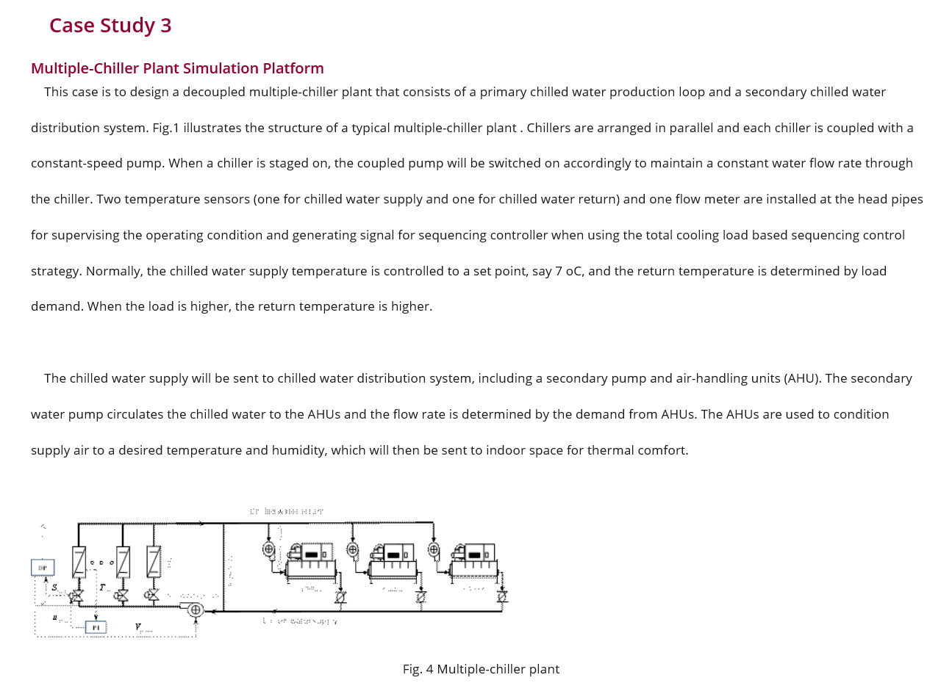
Case 3 in the website

Slide 9
Use of funding
70% budget for three contributing institutes
KTH,
Cith University of HK,
Tsinghua Univ.
30% budget for maintaining the website at Tsinghua University

Slide 10
Thank you.

